Slide 1
Steering Committee
Project - Date

Slide 2
Content
Executive summary
Dashboard
Timeline
Budget Management
Risk Management
KPI’s Management
Project Follow-up
RXXX
RXXXX
Key decisions
Decision A
Decision B
Other
Scope Management
Action list
Samen anders
bankieren
100% Belgische en coöperatieve bank
Verantwoord | Persoonlijk | Respectvol | Verbonden

Slide 3
Executive Summary

Slide 4
<program name> | Dashboard
Budget | Schedule | Scope | Resources | OVERALL
R-Nummer & Status | Project Name | Key Risk | Key Decisions to be made
This table must be used for a Steering Committee in the context of a program or presentation of multiple projects
On Track
At Risk
Out of Track

Slide 5
Rxxxx <project name> | Timeline
Event
Event
Event
Janvier 2020
Février 2020
Core 1 2020
Avril 2020
Mai 2020
Core 2 2020
…
Core 3 2020
Event
Event
Event
Event
Key findings
<Project plan >
< highlight any key elements regarding the planning >
Insert program timeline or project timeline or use the proposed timeline

Slide 6
Rxxxx <project name> | Budget Management
Key findings
<budget management >
< highlight any key elements regarding the budget management >
Copy paste the graph from Budget Management template in Excel –chart graph
Notes:
EAC : effort at completion (total des efforts pour le livrable)

Slide 7
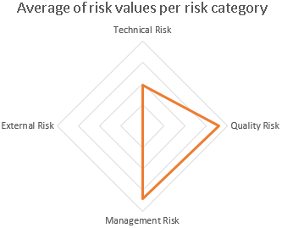
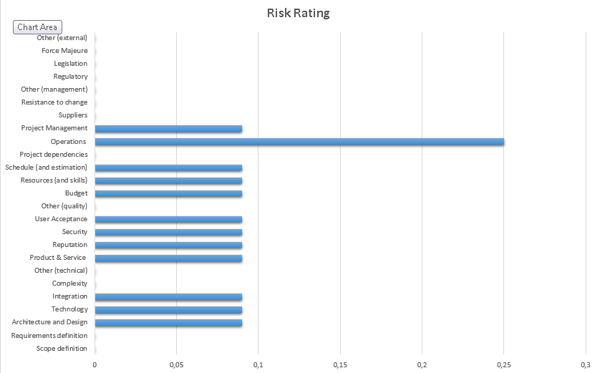
Rxxxx <project name> | Risk Management
Key findings
<risk management >
< highlight any key elements regarding the risk management >
Copy paste the most important elements from Risk Management template in Excel – foresee risk spider diagram in annexe

Slide 8
Rxxxx <project name> | KPI’s Management
Delivery KPI |  | Quality KPI
On time completion ratio |  | Number of errors
Planned workload vs actual workload |  | Customer complaints
Adjustment to the schedule |  | Number of bugs
Milestone ratio |  | Number of versions
 |  | Number of change requests
Budget KPI |  | Risk KPI
Budget Variance |  | Number of risks opened
Number of budget iterations |  | Number of risks closed
Cost performance index
Key findings
<KPI’s management >
< highlight any key elements regarding the KPI’s management
Copy paste the most important elements from KPI’s Management
On Track
At Risk
Out of Track

Slide 9
Project Follow-up

Slide 10
Rxxxx <project name> | Follow-up - Status update
Please give a description of the situation :

Slide 11
- Decision A - Decision B
Key decision

Slide 12
Rxxxx <project name> | Key decision
DESCRIPTION
IMPACT

Slide 13
Rxxxx <project name> | Key decision
Key Decisions
[Insert here the key decisions that must be taken during this steering committee – required elements: scope, proposed solution, remediation, impact, intrusivity, cost ]
...
...

Slide 14
Other

Slide 15
Rxxxx <project name> | Scope change
Scope change Management
Request ID | Request Type | Date of creation | Issuer | Incident description | Priority | Impact | Status | Approuval | Closing date
Key findings
<scope changes >
< highlight any key elements regarding the changes in scope >
Copy paste from Scope Management Template in Excel

Slide 16
Rxxxx <project name> | Action list
Action | Description | Owner | Statut | Deadline

Slide 17
<detail elements in appendix >
Appendix

Slide 18
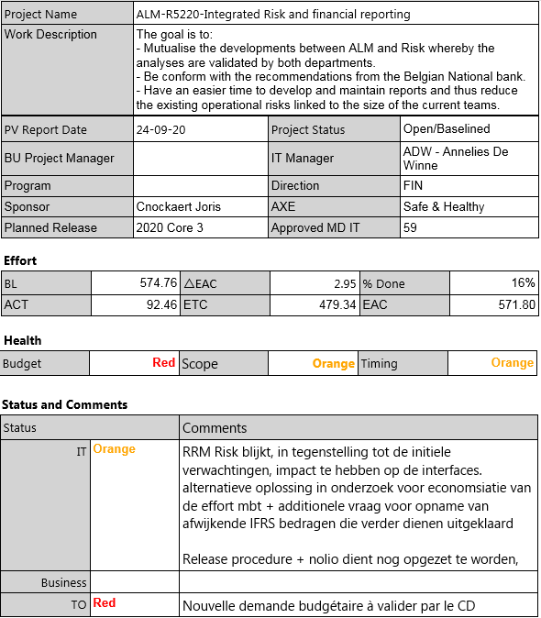
On Track
At Risk
Out of Track

Slide 19
Thank you

